Slide 1
Module 3
Conditional Statements in Python
Decision Making in Python Programming
BBSHRRDB and IMCS, University of Sindh, Jamshoro
Instructor: Muhammd Yousif Memon
MUHAMMD YOUSIF MEMON | PYTHON CONDITIONAL STATEMENTS | JUNE 14, 2026

Slide 2
Learning Objectives
By the end of this session, you will understand:
Core Concepts: What conditional statements are and why decision-making is essential in programming.
Basic Statements: How to use the if and if-else statements.
Advanced Logic: Structuring multiple conditions using the if-elif-else ladder.
Complex Decisions: Implementing nested if statements.
Operators: Utilizing comparison and logical operators to evaluate conditions.
Debugging: Identifying common mistakes and practicing with real-world examples.
MUHAMMD YOUSIF MEMON | PYTHON CONDITIONAL STATEMENTS | JUNE 14, 2026

Slide 3

What are Conditional Statements?
Conditional statements allow a program to execute specific blocks of code only when certain conditions are met. They introduce decision-making capabilities to your scripts.
The Concept
The program evaluates a condition. If the condition is true, it takes one action; if false, it may take another or do nothing.
In Programming
This prevents code from running linearly from top to bottom every time, allowing for dynamic and intelligent software behavior.
Everyday Example
"If a student's marks are greater than 50, then the student passes the exam."
MUHAMMD YOUSIF MEMON | PYTHON CONDITIONAL STATEMENTS | JUNE 14, 2026

Slide 4


Why Do We Need Conditional Statements?
Real-world scenarios require dynamic responses. Conditional logic mimics human decision-making.
Weather Decisions
If it rains, take an umbrella. Otherwise, wear sunglasses.
Security Systems
If the entered password is correct, log in successfully. Otherwise, deny access.
cloud
lock
Grading Systems
If marks are exceptionally high, assign a grade of 'A'.
Legal Requirements
If age is 18 or above, the person is eligible for a driver's license or ID card.
grade
badge
Logical conditions allow programs to branch based on external inputs, just like our daily choices.
MUHAMMD YOUSIF MEMON | PYTHON CONDITIONAL STATEMENTS | JUNE 14, 2026

Slide 5
Basic Syntax of the 'if' Statement
Overview
The if statement is the simplest form of decision-making in Python.
The Condition: Python evaluates the expression next to the keyword. Result must be True or False.
The Colon (:): Mandatory marker. Tells Python a code block is about to start.
Indentation: Uses spaces (usually 4). The indented statement only runs if the condition is True.
Syntax Structure
if condition:
statement
Example Implementation:
if age >= 18:
print("Eligible to vote")
MUHAMMD YOUSIF MEMON | PYTHON CONDITIONAL STATEMENTS | JUNE 14, 2026

Slide 6
Code Example: Simple 'if' Statement
Python Code
age = 18
if age >= 18:
print("You are eligible to vote")
Implementation Detail
Let's look at a practical implementation of a single condition.
Expected Output:
You are eligible to vote
MUHAMMD YOUSIF MEMON | PYTHON CONDITIONAL STATEMENTS | JUNE 14, 2026

Slide 7
Explanation of the 'if' Example
1
Variable Assignment
The variable age is assigned the integer value 18.
2
Condition Evaluation
The program substitutes 18 for age and evaluates 18 >= 18.
3
Boolean Result
The evaluation results in the boolean value True.
4
Execution
Because the condition is True, the indented block (print statement) runs.
info
Alternative Scenario
If the variable age had been 16, the condition would be False, the indented block would be skipped, and nothing would happen.
MUHAMMD YOUSIF MEMON | PYTHON CONDITIONAL STATEMENTS | JUNE 14, 2026

Slide 8
The 'if-else' Statement
The if-else statement is used when you want one block of code to run if a condition is True, and a completely different block to run if it is False.
Key Points
The else Keyword: Notice that else does not take a condition. It acts as a catch-all for any situation where the if condition fails.
Alignment: The else keyword must be aligned perfectly with its corresponding if keyword.
Syntax Structure
if condition:
statement_if_true
else:
statement_if_false
Note: Indentation is mandatory in Python to define the code blocks.
MUHAMMD YOUSIF MEMON | PYTHON CONDITIONAL STATEMENTS | JUNE 14, 2026

Slide 9
Code Example: 'if-else'
Python Code
marks = 45
if marks >= 50:
print("Pass")
else:
print("Fail")
Concept & Result
Applying a fallback action when a condition is not met.
Expected Output
Fail
MUHAMMD YOUSIF MEMON | PYTHON CONDITIONAL STATEMENTS | JUNE 14, 2026

Slide 10
Explanation of 'if-else' Example
How the dual-path logic executes:
01
Variable Assignment
The variable marks is set to 45.
03
Boolean Result
The evaluation result for this specific statement is False.
05
Fallback Execution
Python jumps to the else block and executes it, outputting Fail.
02
Condition Evaluation
Evaluates if marks >= 50:, translating to 45 >= 50.
04
Path Selection
Python skips the indented block under the if statement.
Logic Result
marks = 45
if marks >= 50:
# Skipped
else:
print("Fail")
MUHAMMD YOUSIF MEMON | PYTHON CONDITIONAL STATEMENTS | JUNE 14, 2026

Slide 11
Taking Input with 'if-else'
Python Code
age = int(input("Enter your age: ")) if age >= 18: print("You are an adult") else: print("You are a minor")
Interactive Logic
Making programs interactive by evaluating user input. The input() function captures strings, while if-else handles the branching logic.
warning
The 'int()' Tip
The input() function always returns a string.
To perform mathematical comparisons (like >= 18), you must wrap the input in int() to convert it into an integer.
Example Interaction
Enter your age: 20 You are an adult
MUHAMMD YOUSIF MEMON | PYTHON CONDITIONAL STATEMENTS | JUNE 14, 2026

Slide 12
==
Equal to: Identical values
5 == 5 (True)
Comparison Operators in Conditions
Operators used to compare values and return True or False.
!=
Not equal to: Different values
5 != 3 (True)
<
Less than
2 < 8 (True)
<=
Less than or equal to
4 <= 10 (True)
Pro Tip: The result of a comparison is always a Boolean value: True or False.
MUHAMMD YOUSIF MEMON | PYTHON CONDITIONAL STATEMENTS | JUNE 14, 2026

Slide 13
Logical Operators in Conditions
Operator: and
Returns True ONLY if all combined conditions are True.
Example Usage:
age >= 18 and age <= 60
Checks if age is between 18 and 60.
Operator: or
Returns True if at least one of the conditions is True.
Example Usage:
marks >= 50 or attendance >= 75
Passes if either marks OR attendance is high enough.
Operator: not
Reverses the result of the condition (True becomes False).
Example Usage:
not is_raining
Executes if it is currently NOT raining.
MUHAMMD YOUSIF MEMON | PYTHON CONDITIONAL STATEMENTS | JUNE 14, 2026

Slide 14

Code Example: Logical Operator 'and'
Combining multiple requirements using and.
Python Code:
marks = 75
attendance = 80
if marks >= 50 and attendance >= 75:
print("Allowed in exam")
else:
print("Not allowed in exam")
Expected Output:
Allowed in exam
fact_check
Logic: Both Conditions True
MUHAMMD YOUSIF MEMON | PYTHON CONDITIONAL STATEMENTS | JUNE 14, 2026

Slide 15
The 'if-elif-else' Statement
Used when you have more than two possible paths or multiple conditions to check sequentially.
Key Components:
elif: Stands for "else if". You can have as many elif blocks as you need between the if and the else.
Execution: Python checks them from top to bottom. As soon as it finds one that is True, it runs that block and skips the rest.
Syntax Structure
if condition1: statement1 elif condition2: statement2 else: statement3
MUHAMMD YOUSIF MEMON | PYTHON CONDITIONAL STATEMENTS | JUNE 14, 2026

Slide 16
Code Example: Grade System
Python Code Snippet
marks = int(input("Enter marks: "))
if marks >= 80:
print("Grade A")
elif marks >= 70:
print("Grade B")
elif marks >= 60:
print("Grade C")
elif marks >= 50:
print("Grade D")
else:
print("Fail")
Categorizing Data
Using elif to categorize data into multiple tiers based on numerical boundaries.
TERMINAL OUTPUT
Enter marks: 85
Grade A
info The logic stops at the first true condition encountered in the chain.
MUHAMMD YOUSIF MEMON | PYTHON CONDITIONAL STATEMENTS | JUNE 14, 2026

Slide 17
Explanation of the Grade System
How Python navigates the elif ladder:
1
Top-to-Bottom Evaluation
Python always starts at the first if statement and works its way down.
2
First Match Wins
The very first condition that evaluates to True is executed.
3
Skipping the Rest
Once a match is run, all remaining elif and else blocks are completely skipped.
4
The Fallback
The final else block only executes if absolutely all conditions above it evaluate to False.
MUHAMMD YOUSIF MEMON | PYTHON CONDITIONAL STATEMENTS | JUNE 14, 2026

Slide 18
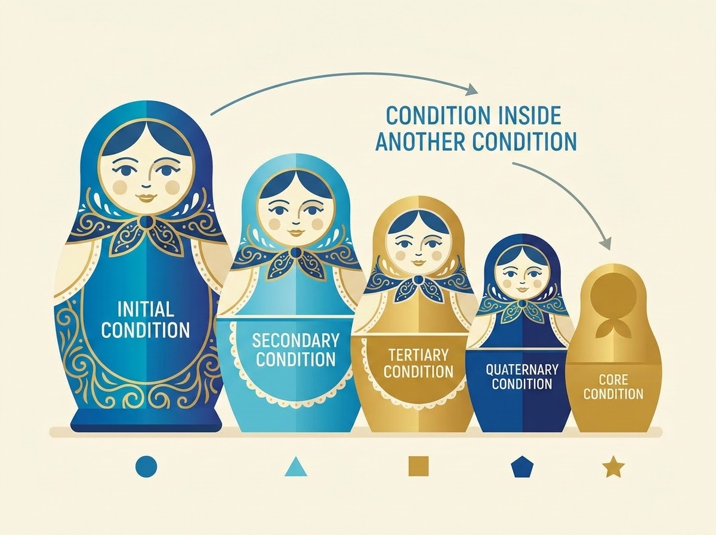
Nested 'if' Statements
Concept Overview
A nested if statement is simply an if statement placed inside another if statement.
The Concept: You only want to check a second condition if the first condition is already proven to be true.
Indentation: The inner if statement must be indented further to show it belongs inside the outer block.
Common Use Case: A login system. First, check if the username exists. Only if the username is correct, then check if the password matches.
Visual Analogy: Nesting
MUHAMMD YOUSIF MEMON | PYTHON CONDITIONAL STATEMENTS | JUNE 14, 2026

Slide 19
Code Example: Nested 'if'
Python Code
Validating credentials sequentially.
username = input("Enter username: ")
password = input("Enter password: ")
if username == "admin":
if password == "12345":
print("Login successful")
else:
print("Wrong password")
else:
print("Wrong username")
Example Output
Enter username: admin
Enter password: 12345
Login successful
MUHAMMD YOUSIF MEMON | PYTHON CONDITIONAL STATEMENTS | JUNE 14, 2026

Slide 20
Common Mistakes to Avoid
warning
Syntax and Logic Pitfalls
Beginners frequently encounter these syntax and logic errors:
Forgetting the Colon (:): Omitting the colon at the end of an if, elif, or else line causes a syntax error.
Wrong Indentation: Inconsistent spacing will crash your program or cause logic to run at the wrong time.
Using = instead of ==: Using a single equals sign (assignment) inside a condition instead of the double equals sign (comparison).
Not Converting Input Type: Forgetting to wrap input() with int() or float() when comparing numbers.
Wrong Condition Order: Putting a broader condition before a more specific one in an elif ladder.
MUHAMMD YOUSIF MEMON | PYTHON CONDITIONAL STATEMENTS | JUNE 14, 2026

Slide 21
Common Mistake Example: Input Types
warning
Wrong Code (Causes Error)
input() returns a string (text). You cannot mathematically compare a string to an integer (50).
Correct Code
We use int() to convert the text input into a whole number before the comparison.
marks = input("Enter marks: ") if marks >= 50: print("Pass")
Error: Comparison not possible
marks = int(input("Enter marks: ")) if marks >= 50: print("Pass")
Fix applied: Type conversion
MUHAMMD YOUSIF MEMON | PYTHON CONDITIONAL STATEMENTS | JUNE 14, 2026

Slide 22
Practice Example 1: Even or Odd
Problem Statement
Task:
Write a program that takes a number from the user and checks if it is even or odd.
Logic Concept:
The modulo operator (%) returns the remainder of division.
If a number divided by 2 has a remainder of 0, it is even.
Python Solution
num = int(input("Enter a number: "))
if num % 2 == 0:
print("Even number")
else:
print("Odd number")
Tip: Use the % operator to determine divisibility.
MUHAMMD YOUSIF MEMON | PYTHON CONDITIONAL STATEMENTS | JUNE 14, 2026

Slide 23
Practice Example 2: Largest of Two Numbers
Problem Statement
Find and display the larger number between two user inputs.
Requirement:
• Handle user input for two variables.
• Compare both values using comparison operators.
• Address three potential outcomes: a > b, b > a, or equality.
lightbulb Uses if-elif-else logic.
Python Solution
a = int(input("Enter first number: "))
b = int(input("Enter second number: "))
if a > b:
print("First number is larger")
elif b > a:
print("Second number is larger")
else:
print("Both numbers are equal")
Tip: Converting input to int() is necessary for mathematical comparison.
MUHAMMD YOUSIF MEMON | PYTHON CONDITIONAL STATEMENTS | JUNE 14, 2026

Slide 24
Mini Classroom Activity
Now it's your turn! Try writing Python code for the following scenarios:
1
Eligibility
Ask for age. Print "Eligible for license" if 18+, else print "Not eligible".
3
Grading
Implement a basic grading system (A, B, Fail) based on a score.
2
Number Check
Take a number. Check if it is Positive, Negative, or Zero.
4
Login
Create a simple username/password check using nested if statements.
MUHAMMD YOUSIF MEMON | PYTHON CONDITIONAL STATEMENTS | JUNE 14, 2026

Slide 25
Summary
Decisions: Conditional statements allow programs to make decisions based on dynamic data.
if: Runs code only if a condition is True.
if-else: Provides two paths (True path and False path).
if-elif-else: Handles multiple sequential conditions.
Nested if: Places conditions inside other conditions for complex logic.
warning
Syntax Tip
Always remember your colons (:), strict indentation, and correct comparison operators (==, >, etc.).
MUHAMMD YOUSIF MEMON | PYTHON CONDITIONAL STATEMENTS | JUNE 14, 2026

